Slide 1
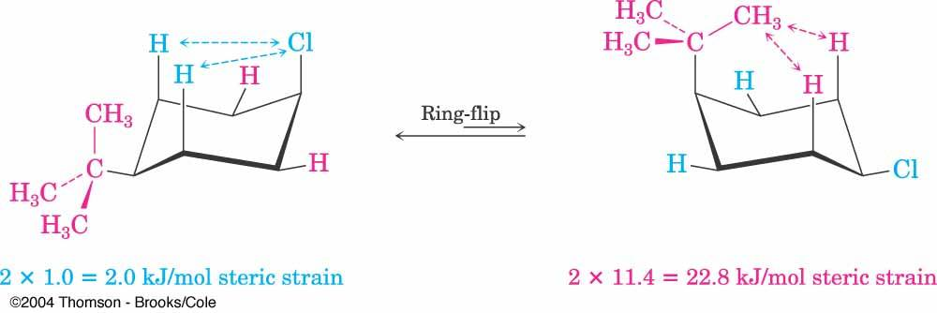
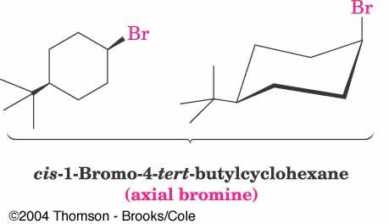
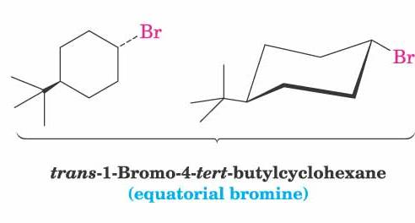
Effect of tert-Butyl Group

Slide 2
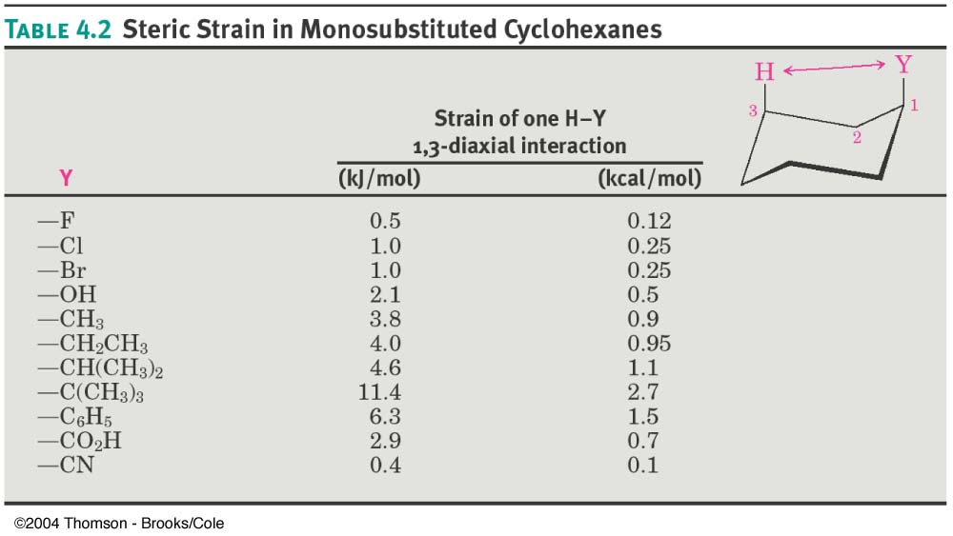
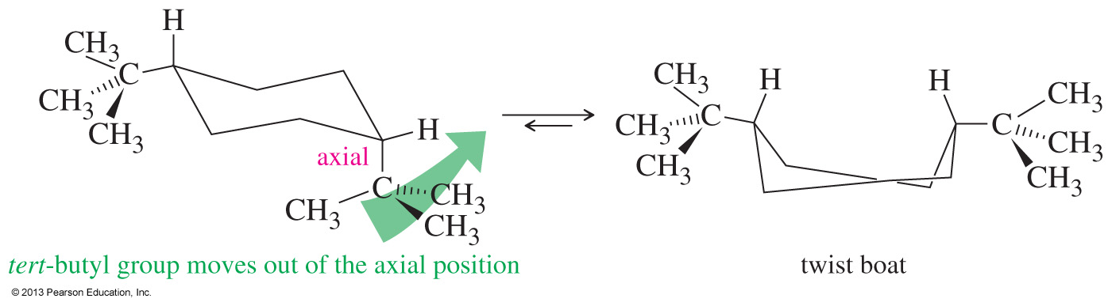
Large Interaction Energies can Preclude the Formation of Chair Conformation
The most stable conformation of cis-1,4-di-tert-butylcyclohexane is the twist boat.
Both chair conformations require one of the bulky t-butyl groups to occupy an axial position.

Slide 3
Why do We Study Conformations?
Conformations can dictate reactivity.
Let’s draw the conformations of cyclohexane derivative 1.
most stable conformation

Slide 4
Conformations Influence Reactivity
What about the compound 2?.
Let’s draw the conformations of cyclohexane derivative 2.
Both similar in energy so there is no significant preference for one over the other
No possibility of epoxide formation from either of these conformations!

Slide 5
Conformations Influence Reactivity
2-Aminocyclohexanols also exhibit such conformation dependent reactivity.
trans-2-Aminocyclohexanol affords cyclopentane carboxaldehyde as the major product
cis-2-Aminocyclohexanol affords an ~1:1 mixture of cyclopentane carboxaldehyde and cyclohexanone

Slide 6
Conformations Influence Reactivity
trans-2-Aminocyclohexanol has a preferred major conformation wherein both substituents are equatorial

Slide 7
Conformations Influence Reactivity
cis-2-Aminocyclohexanols has two conformations both of which have one substituent in the equatorial position and the other in axial position.

Slide 8
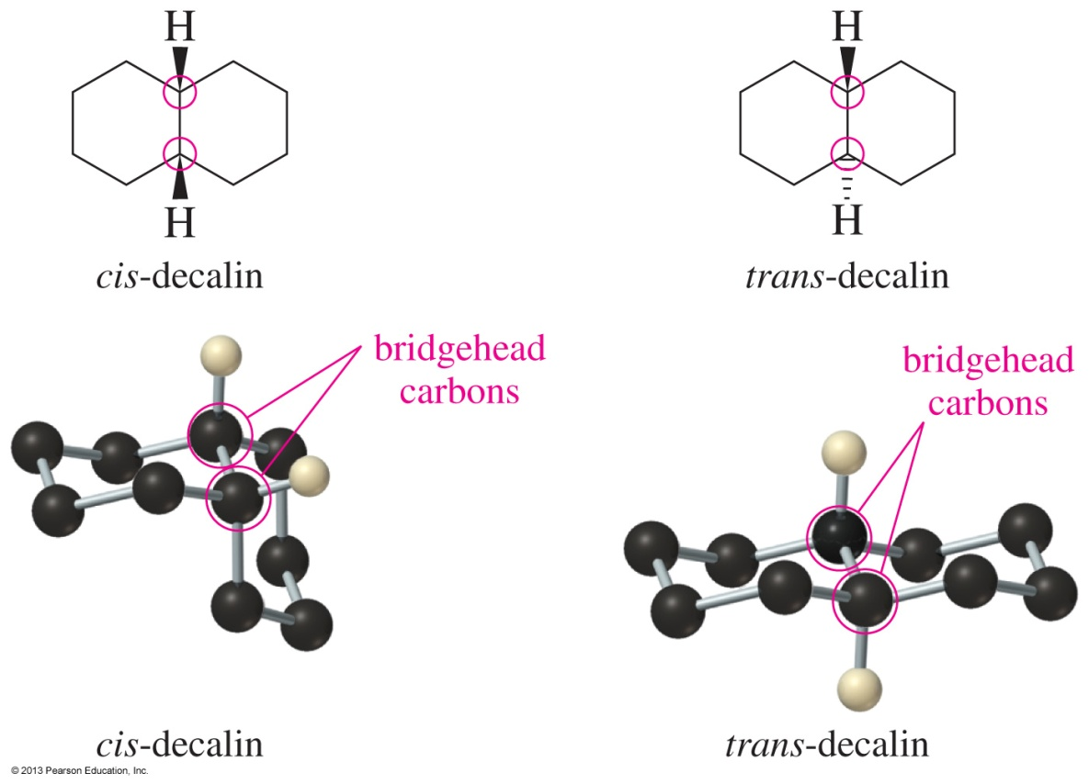
If One Cyclohexane Ring is Not Tickling Your Brain Cells…..
Decalins are fused bicyclic compounds (10 carbon atoms) wherein the ring junctions can be either cis- or trans.
The six-membered rings in cis- and trans-decalin assume chair conformations.

Slide 9
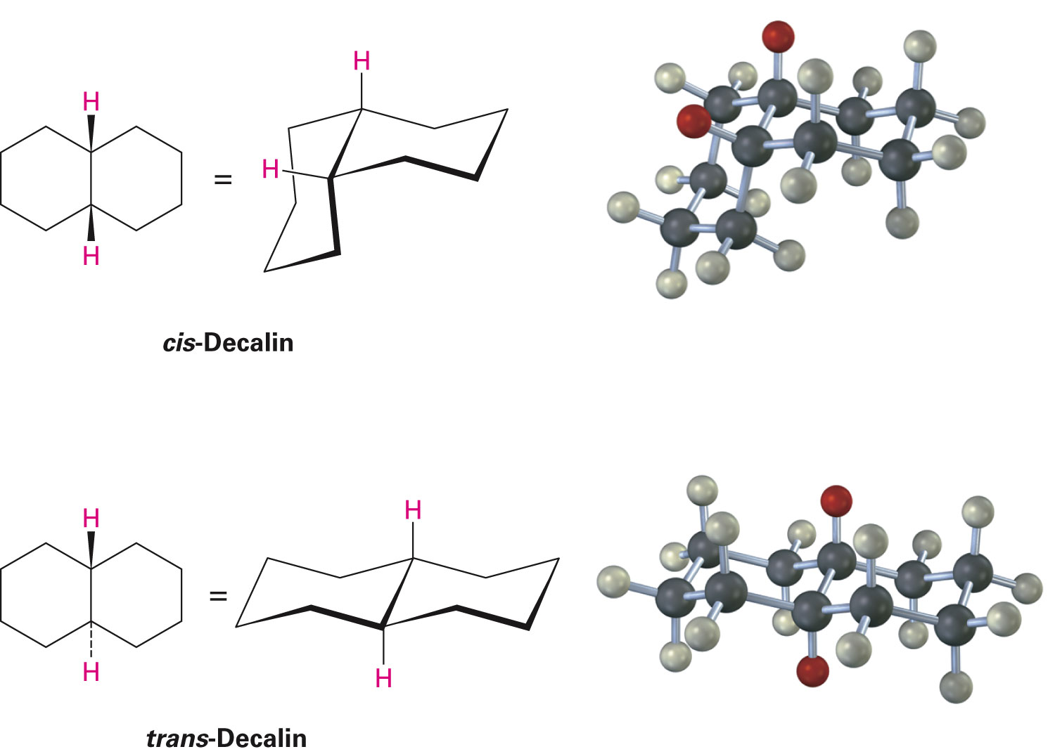
Decalin Ring System
In cis-decalin hydrogen atoms at the bridgehead carbons are on the same face of the rings
In trans-decalin, the bridgehead hydrogens are on opposite faces
Both compounds can be represented using chair cyclohexane conformations
Flips and rotations do not interconvert cis and trans (why?)

Slide 10
cis- and trans-Decalins Are Not Conformers
cis- and trans-decalin DO NOT interconvert.
Interactions in cis- and trans- decalin
trans-decalin is lower in energy by 2.7 kcal/mol

Slide 11
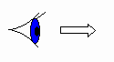
Conformational Mobility of cis- and trans-Decalins
trans-decalin CANNOT undergo a ring flip.
cis-decalin CAN undergo a ring flip.

Slide 12
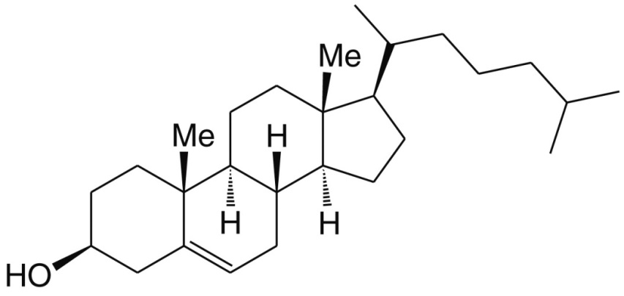
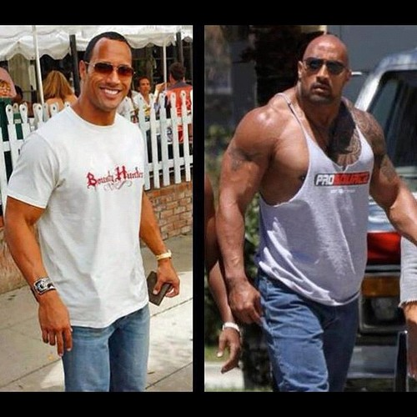
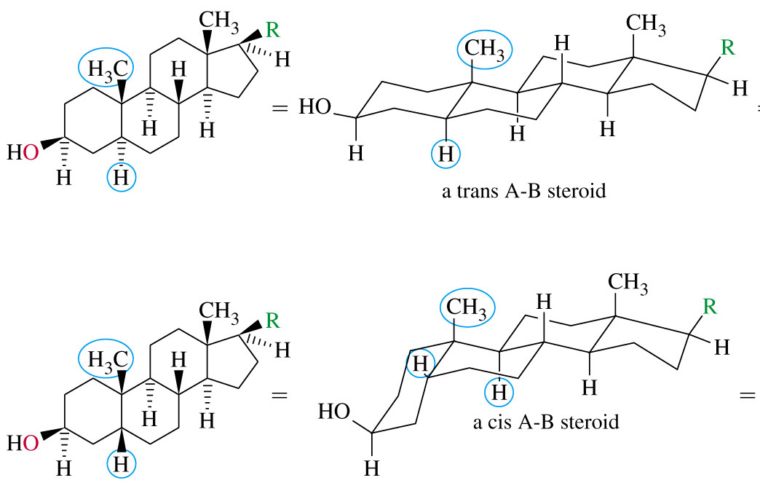
Polycyclic Ring Systems
Cholesterol is a waxy steroid found in the cell membranes. It is an essential component of mammalian cell membranes.
Corticosteroids: metabolism & immune function
Anabolic Steroids: muscle & bone growth

Slide 13
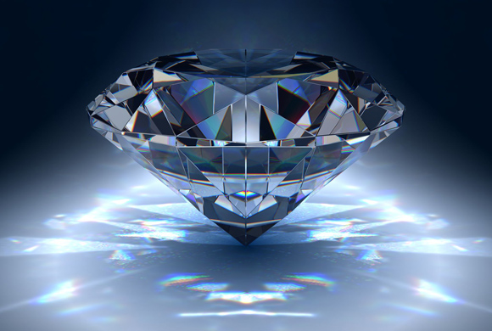
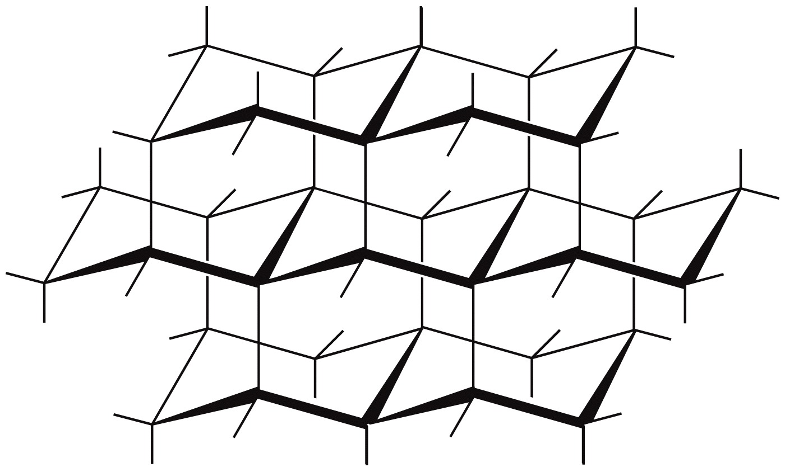
Polycyclic Ring Systems
Diamonds are formed by fusing many chairs together three dimensionally in all directions

Slide 14
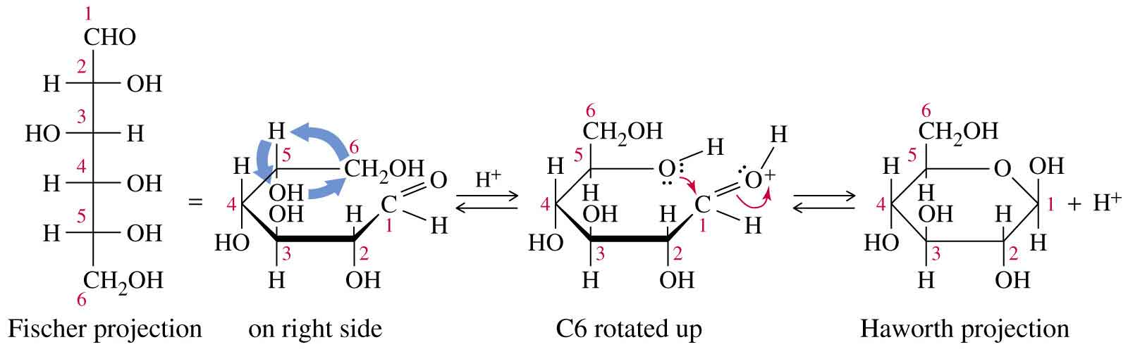
Chair Conformations are Ubiquitous In Nature
Consider glucose, a member of the carbohydrate family of biomolecules.
Glucose exists almost entirely as its cyclic hemiacetal form.
The Haworth projection, although widely used, may give the impression of the ring being flat.

Slide 15
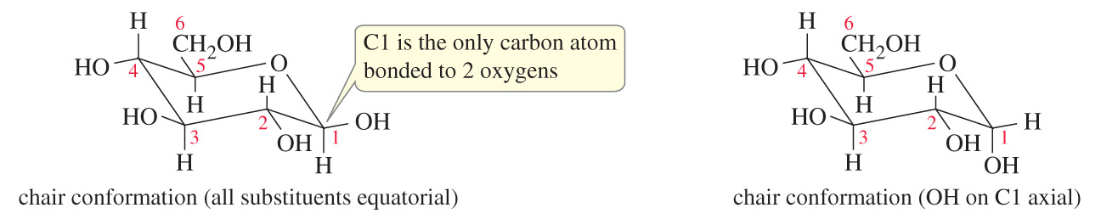
Chair Conformations are Ubiquitous In Nature
Glucose exists in the two forms shown below.
The only difference in the two molecules is that the stereochemistry at the C1 carbon atom is different.
Stereoisomeric molecules which differ in the configuration at only one stereogenic center are called epimers.

Slide 16
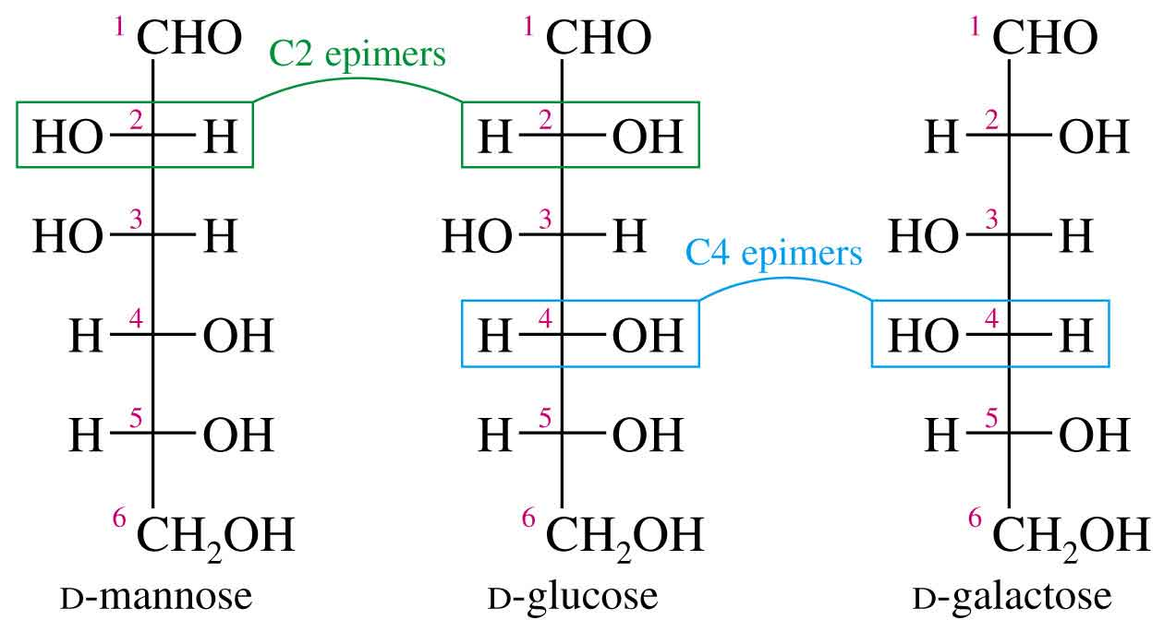
Epimers
Epimers are stereoisomers that differ in the configuration at only one stereogenic center.
The carbon at which the stereochemistry differs is usually specified.
=>

Slide 17
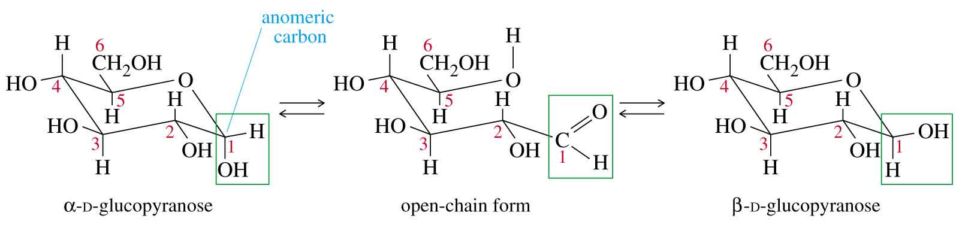
Epimers and Anomers
Anomers are actually epimers that differ in configuration at the acetal/hemiacetal carbon.
This carbon atom is also referred to as the “anomeric carbon”.
Two anomers of D-glucose are shown below.
The hydroxyl group on the anomeric (hemiacetal) carbon is down (axial) in the α anomer and up (equatorial) in the β anomer.
The β anomer of glucose has all its substituents in equatorial positions.
The hemiacetal carbon is called the anomeric carbon, easily identified as the only carbon atom bonded to two oxygens.

Slide 18
Does the α-anomer Exist in Significant Amount?
Despite what we saw for cyclohexane (huge preference for the equatorial position), the corresponding α-D-glucose is present in significantly higher ratio.
36%
64%
The axial substituent in this case seems to be more stabilized compared to the
corresponding cyclohexanol.
11%
89%

Slide 19
Anomeric Effect
Alkyl substituents in cyclohexane prefer
Equatorial position.
Alkyl substituents in tetrahydropyran prefer
equatorial position.
The anomeric carbon of the most
abundant natural sugar, D-glucopyranose,
also prefers the –OH substituent in
equtorial orientation.
36%
64%
Making the substituent more
electronegative rendered the axial
conformer more stable!
86%
14%
94%
06%

Slide 20
Anomeric Effect
Orbital Overlap
σ*_{C-X}
σ*_{C-X}
Overlap between lone pair of oxygen
and antibonding orbital of C-X possible
Overlap NOT possible
As an extreme case, we can imagine complete donation of the lone pairs to give the following resonance structure
Just like with any set of resonance
structures, the “reality” is an
average of what the
structures depict.

Slide 21
Evidence for Anomeric Effect
The two C-Cl bonds in the molecule shown
are of different lengths, as indicated.
Analysis of potential anomeric effect can provide the answer.
Anomeric effect is
operative for C-Cl
A corresponding decrease in the C-O bond length is also observed.

Slide 22
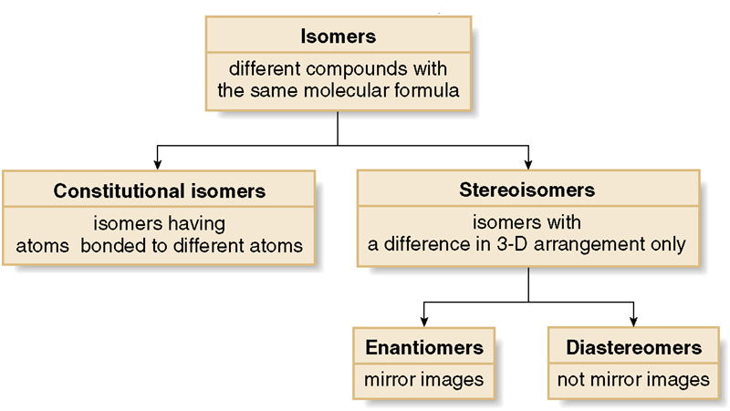
Isomerism in Organic Compounds
Types of Isomers

Slide 23
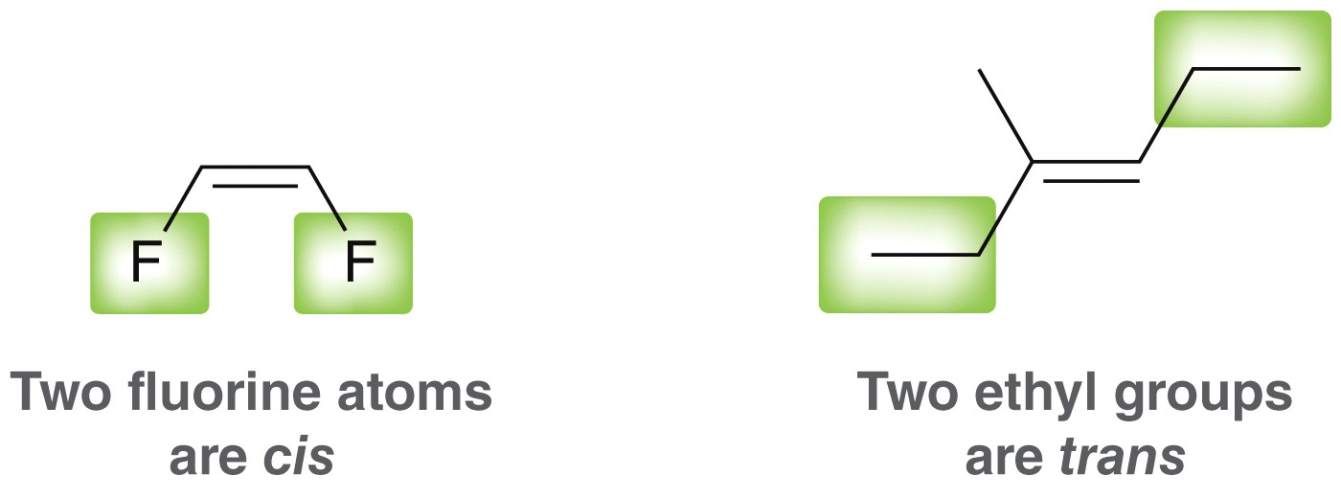
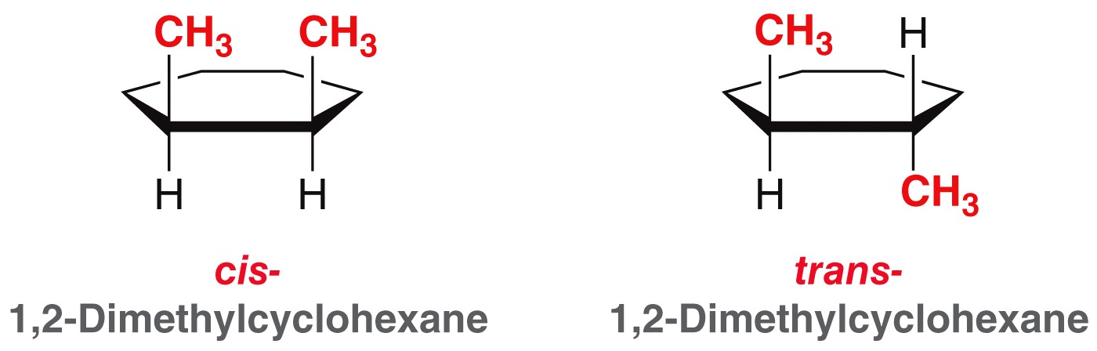
Stereoisomerism
Isomers that have the same connectivity between atoms but different spatial arrangement of their atoms are called stereoisomers.
With rings and with C=C double bonds, cis-trans notation is used to distinguish between stereoisomers
Cis – Higher priority (CIP notation) groups are positioned on the SAME side of a ring/double bond
Trans – Higher priority (CIP notation) groups are positioned on OPPOSITE sides of a ring/double bond

Slide 24
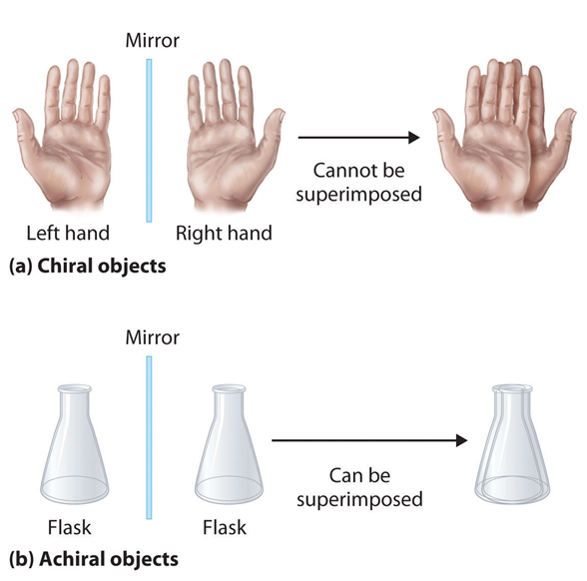
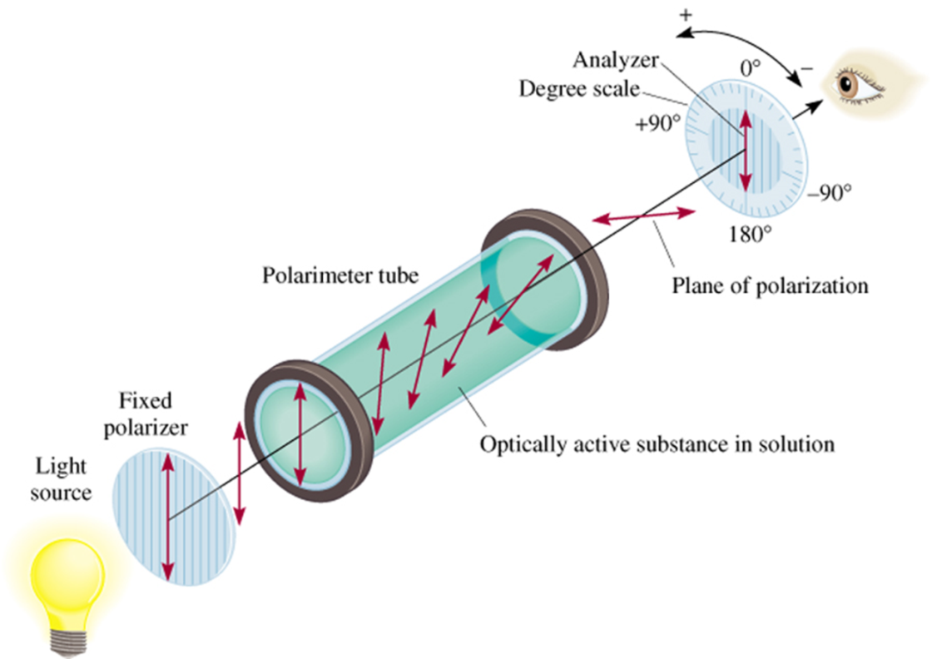
Stereoisomerism
Optical Isomerism
Optical isomers, or enantiomers, are mirror images of one another that don’t superimpose on each other.
Such entities are said to be chiral.
Their properties of chiral chemicals differ from each other only when they interact with other chiral entities (such as plane polarized light).

Slide 25
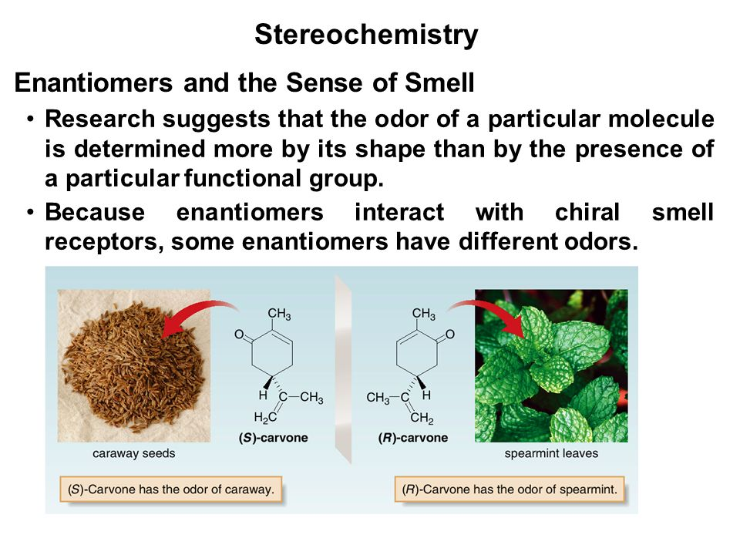
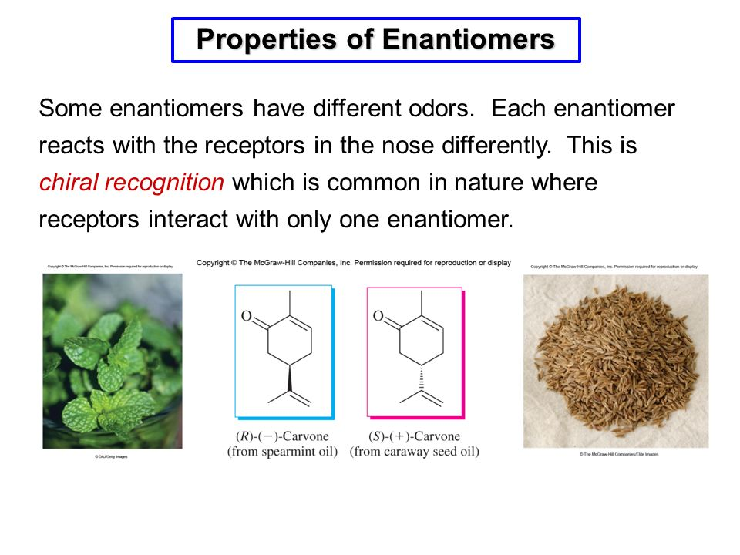
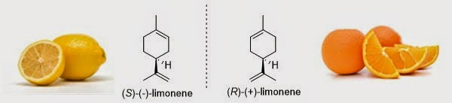
An Interesting Side-Note About Enantiomers
How can we distinguish the following two enantiomers?
There are more such enantiomeric pairs!

Slide 26
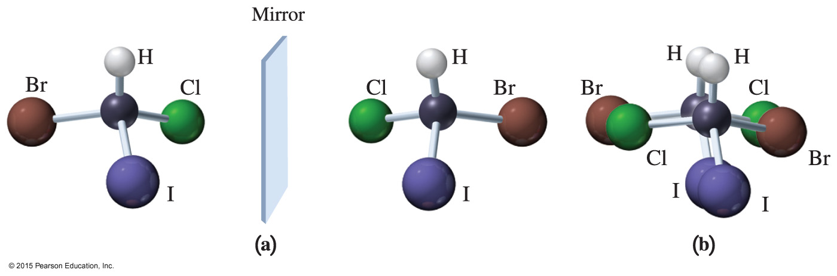
Chirality Associated with Tetrahedral Carbon Atom
There can be many reasons for chirality to occur. We will discuss some of them.
If a carbon atom is bonded to 4 unique groups of atoms, it results in chirality.
Such a carbon atom is referred to being as “chiral”.

Slide 27
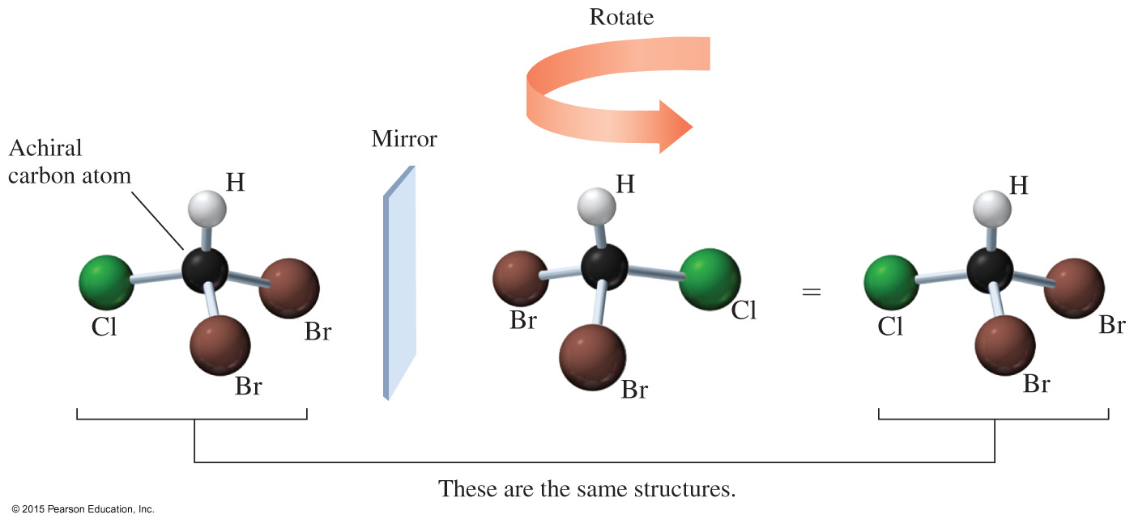
Achiral Carbon Atoms
When the mirror image of an achiral structure is rotated, and the structures can be aligned with each other, their mirror images are said to be superimposable.

Slide 28
Conformationally Mobile Systems
Should the (cis)-1,2-dimethylcyclohexane chair conformation be chiral or achiral?
It is not superimposable on its mirror image
Mirror plane
The freely interconverting mirror images cancel out their optical rotation, so it is achiral

Slide 29
trans-1,2-dimethylcyclohexane is Chiral
Should the (trans)-1,2-dimethylcyclohexane chair conformation be chiral or achiral?
It is also not superimposable on its mirror image
Mirror plane

Slide 30
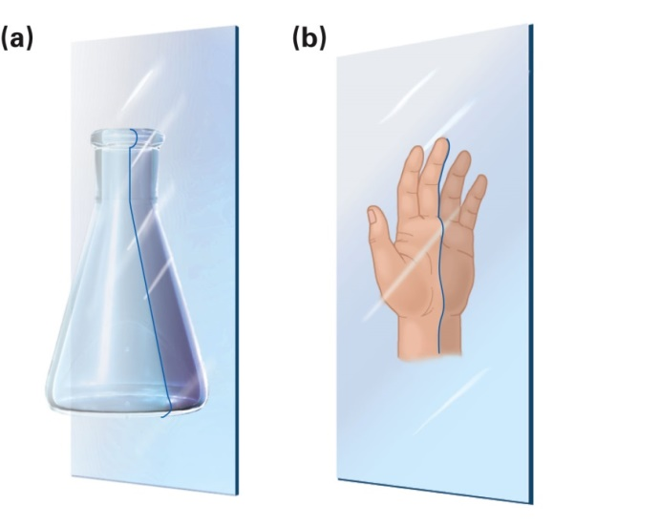
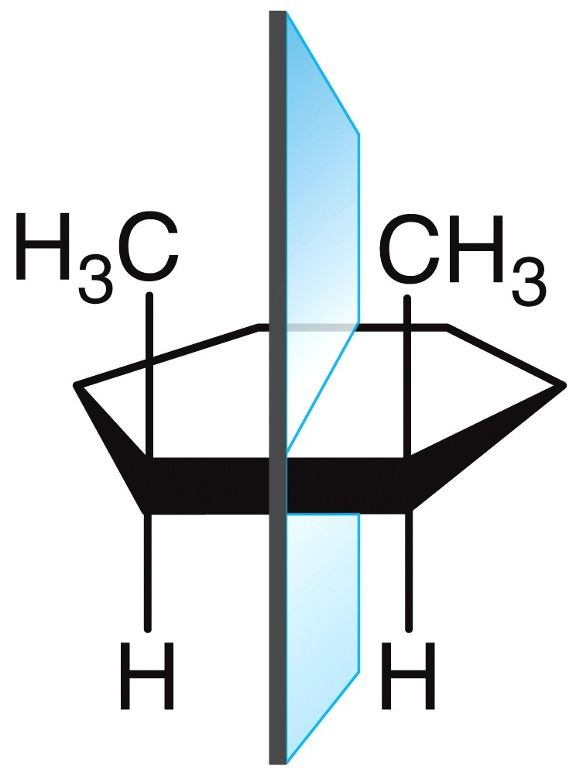
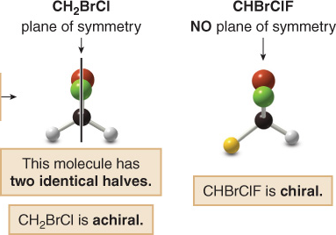
Optical Isomerism
Do we need to draw mirror images every time
we want to think about enantiomers?
Enantiomers do not have a plane of symmetry
Any molecule which possesses a plane of
symmetry is superimposable on its mirror image
and hence is achiral
Molecules that have chiral centers but also have a plane of symmetry are referred to as “Meso” compounds.

